Slide 1
An Odyssey of Representation Learning
Yuan YAO
HKUST

Slide 2
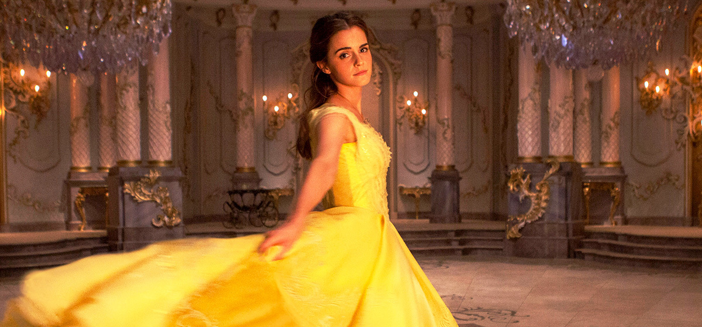


Machine Learning has a Dream…

Slide 3
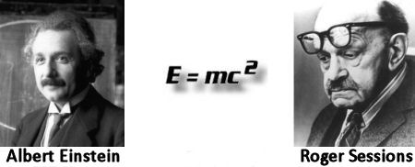
First principle for “Data Scientists”
You have to know what you are doing …
Principle of Parsimony (Occam’s Razor): Everything should be kept as simple as possible, but no simpler. --Albert Einstein

Slide 4
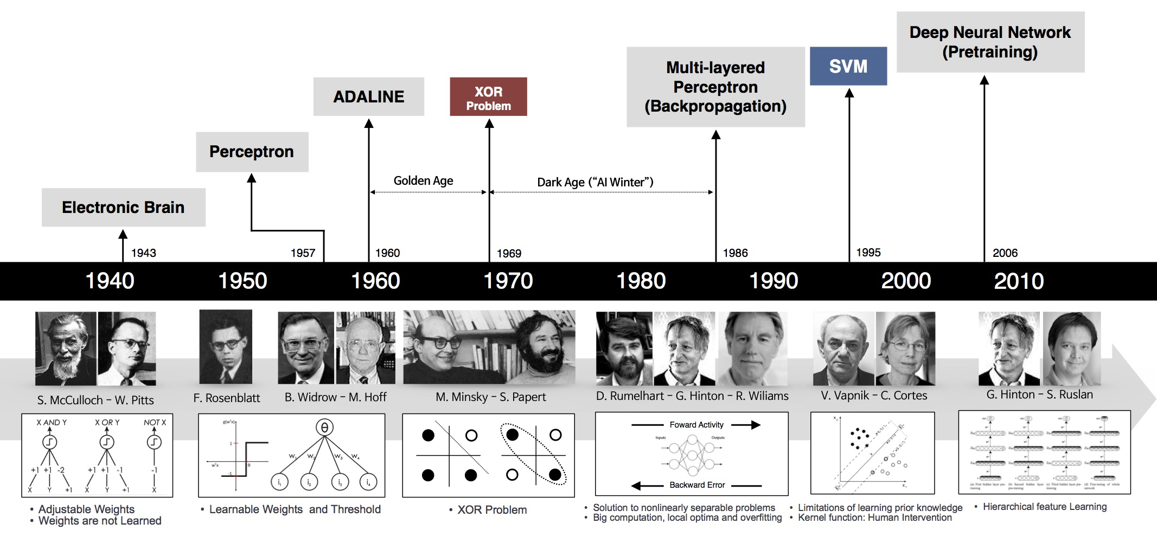
A Brief History of Neural Networks

Slide 5
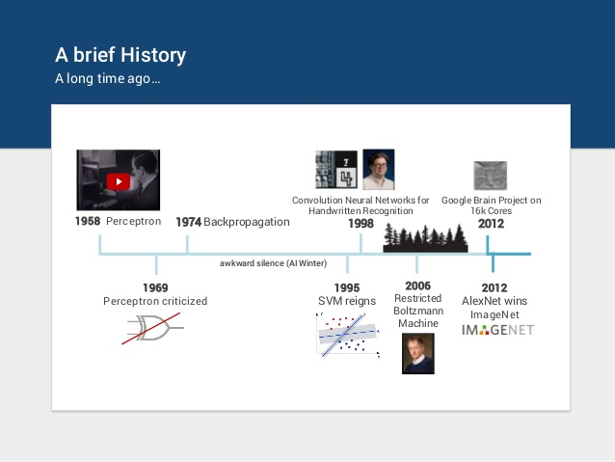
Return of “Deep Representation” Learning ~ 2012

Slide 6
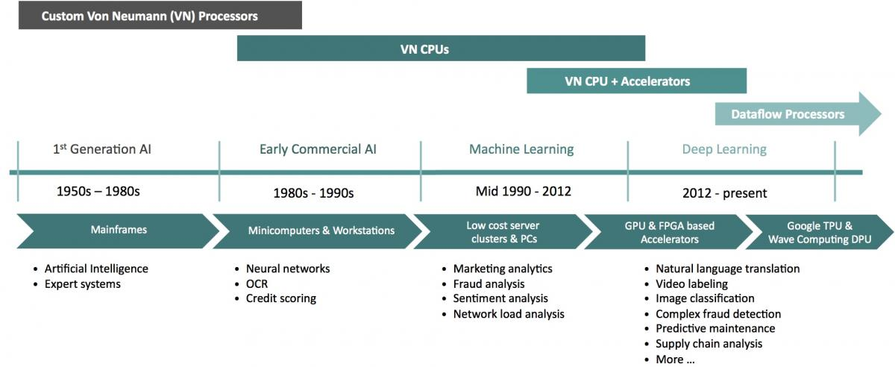
Hardware waves

Slide 7
1-Hidden Layer Neural Networks
A two-stage regression or classification model

Slide 8
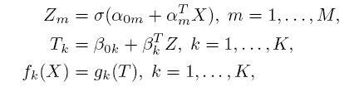
Single-Hidden Layer NN
Linear combination of X + sigmoid -> Z hidden layer
Linear combination of Z + softmax -> Y

Slide 9
Sigmoid Hidden Layer
Sigmoid σ（ע）=exp(y)/(1+exp(y))=1/(1+exp(-y))

Slide 10
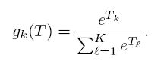
Softmax Output
Softmax output

Slide 11
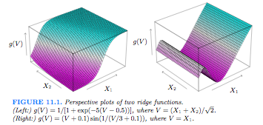
Projection Pursuit Regression
Ridge function g_{m}(<w,X>): projection of X along w，then use that as features for regression
Universal approximation of continuous functions when M grows to arbitrarily large numbers

Slide 12
Least Square Fitting for PPR
Objective function
M and g can be tuned to avoid over-fitting, e.g. cross-validation

Slide 13
Weighted Least Square
M=1，choose initial w₀，estimate g, e.g. splines
Given g， estimate w by minimizing the least square loss
A second order Taylor expansion:
Least square regression leaves the following weighted least square:

Slide 14
Training of Neural Networks
Weights are unknown parameteres, denoted by θ
Loss: sum-of-square error for regression and cross-entropy (deviance) for classification

Slide 15
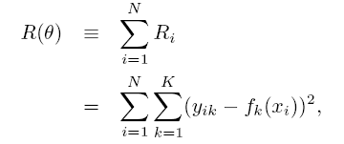
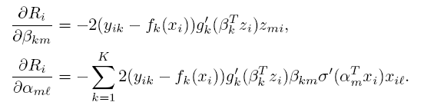
Least Square Fitting: Backpropogation (BP)
Sum-of-Square error
Derivative: Chain Rule for Composite Functions

Slide 16
Gradient Descent
Weights are updated by gradient descent

Slide 17
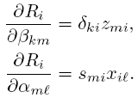
BP Equation
Gradients can be rewritten as
where and are errors in the output layer and hidden layer, satisfying the Backpropogation Equation

Slide 18
BP algorithm: Foreward and Backward
Forward: given weights, compute predicted value
Backward: compute error ，then by BP equation
Upgrade gradients using these errors
Stochastic gradient descent algorithm for big data by taking a small batch of samples for every gradient update

Slide 19
11.4 Learning rates
Step size γ is called Learning rates
Batch learning: take all samples in the data to compute the gradients, when learning rates are often constants
Online learning: take one (or mini-batch) sample after another to compute the gradients, when learning rates are
decay for numerical convergence
constants for fast tracking of data flow

Slide 20
Some challenges in NN training
Initial choice
Can’t be 0, which is a stationary point of BP algorithm
Random intialization
pretraining
Local Optima
Regularization
Weight sharing
Perturbation of weights: drop out hidden units or parameters
Architecture selection

Slide 21
神经网络训练的一些问题
过分拟合？
权衰减是一种更加直接的正则化方法
将惩罚项加入误差函数得到
Ridge/LASSO etc.
λ是大于0的调整参数，较大的值使权值向0收缩。 值由交叉验证估计
还可以weight sharing (restricted)

Slide 22
神经网络训练的一些问题
输入的scale对于结果的影响？
最好对于所有的输入都进行标准化，这个可以保证在正则化过程中平等的对数据进行处理，而且为随机初值的选择提供一个有意义的值域
一般在[ -0.7, 0.7]上面随机选取均匀的权值
隐藏单元和层的数目：隐藏单元过少则模型可能不具备足够的灵活性，如果隐藏单元过多，则多余的收缩到0. 一般来说隐藏单元的数量在5到100之间，可以取合理大的数量，在用正则化加以训练，使得多余的变作0.
Deep networks?

Slide 23
Example: Hand-written Digits

Slide 24
LeNets: five networks by LeCun

Slide 25
LeNet-4/5: weight sharing

Slide 26
Test Performance

Slide 27
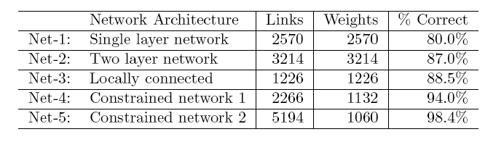
Test Performance

Slide 28
Deep Learning?
Multilayer Perceptron tutorial: Yue JIANG
Tensorflow Tutorial: Lizhang MIAO
Reinforcement learning: Akhan ISMAILOV
Some References
IPAM-UCLA 2012 Summer School: Deep Learning, Feature Learning:http://www.ipam.ucla.edu/programs/gss2012/ contains various video streams and slides
Andrew Ng’s course at Stanford, Unsupervised Feature Learning and Deep Learning: http://ufldl.stanford.edu/wiki/index.php/UFLDL_Tutorial
Simons Institute Representation Learning 2017: https://simons.berkeley.edu/workshops/schedule/3750

Slide 29
Sparse Dictionary Learning
From Shallow Learning to Deep Learning

Slide 30

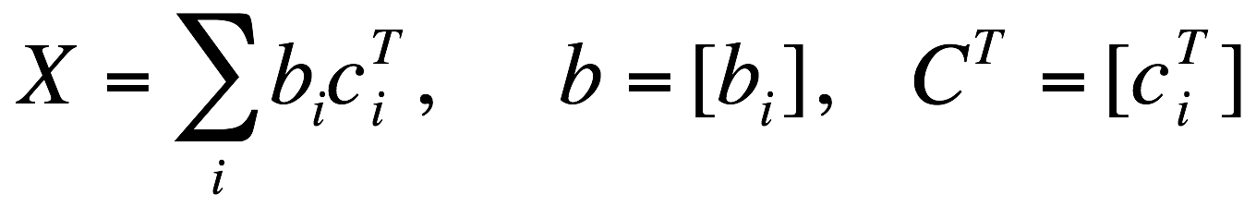
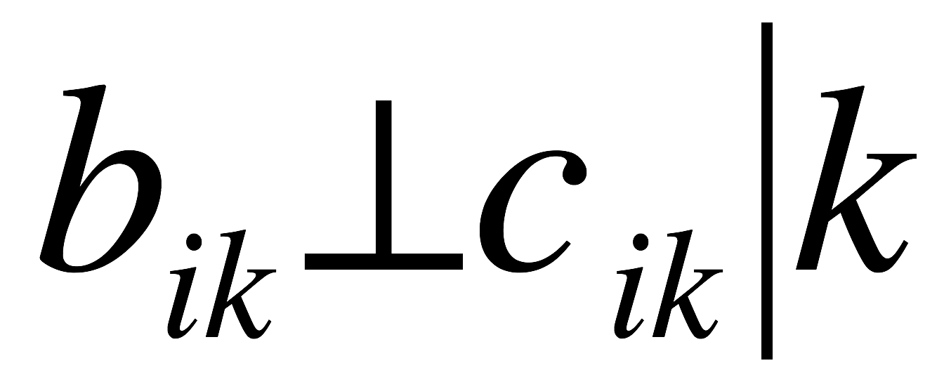
Unsupervised Learning as matrix factorization
Shallow Learning of X:
SVD/PCA: orthogonal B, C
Topic models: nonnegative B, C
Sparse coding/dictionary learning: B is dictionary (basis, frame, etc.), C is sparse
Conditional independence:

Slide 31
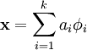
Sparse Coding
The aim is to find a set of basis vectors (dictionary) such that we can represent an input vector x as a linear combination of these basis vectors:
PCA: a complete basis
Sparse coding: an overcomplete basis to represent (i.e. such that k > n)
The coefficients a_{i} are no longer uniquely determined by the input vector x
Need additional criterion of sparsity to resolve the degeneracy introduced by over-completeness.

Slide 32
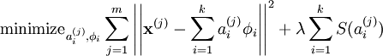
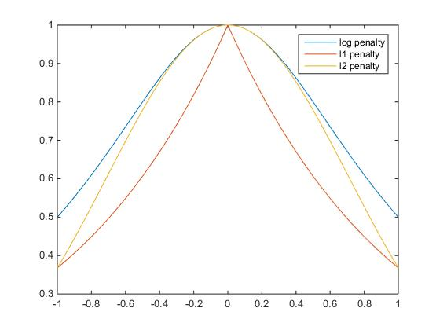
Sparsity Penalty
We define the sparse coding cost function on a set of m input vectors as
where S(.) is a sparsity cost function which penalizes a_{i} for being far from zero.
"L₀-norm”:
L₁ penalty:
log penalty:

Slide 33
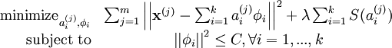
Scale freedom
In addition, it is also possible to make the sparsity penalty arbitrarily small by scaling down a_{i} and scaling up by some large constant.
To prevent this from happening,
Olshausen and Field 1996

Slide 34
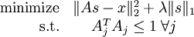
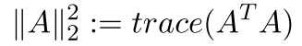
Identifiability: Scale
One can remove the scale degree of freedom either in constraint form
Or Lagrangian form:
where is simply the sum of squares of the entries of A (squared Frobenius norm)

Slide 35
Nonlinear Optimization
Bi-variate cost: not jointly convex, not differentiable
But J(A,s) is convex in A fixed s, and convex in s fixed A.

Slide 36
Alternating Optimization
Initialize A randomly
Repeat until convergence
Find the s that minimizes J(A,s) for the A found in the previous step (LASSO)
Solve for the A that minimizes J(A,s) for the s found in the previous step (Ridge Regression -> SVD)

Slide 37
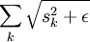
Smoothing
So our final objective function:
where is shorthand for
the third term is simply the sum of squares of the entries of A (squared Frobenius norm)
Then you have a smooth objective function, restricted convex in A and s
Gradient descent such as BP algorithm can be applied here

Slide 38
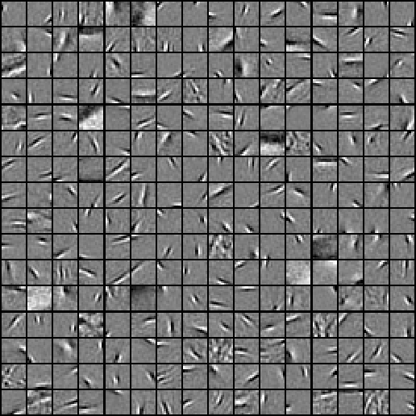
Dictionary Learned from natural image patches
http://ufldl.stanford.edu/wiki/index.php/Exercise:Sparse_Coding
http://ufldl.stanford.edu/wiki/resources/sparse_coding_exercise.zip

Slide 39
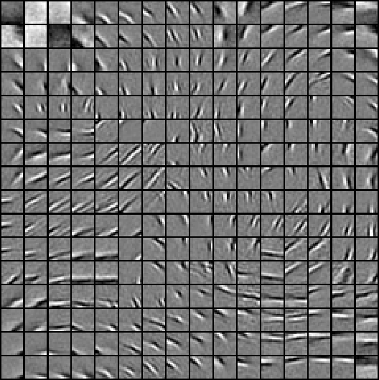
Adjacent features should be similar?

Slide 40
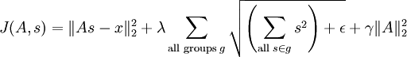
Topographic Sparse Coding: Group LASSO
Group adjacent features in group LASSO norm
Example: 3-by-3 neighborhood as ‘adjacency’

Slide 41
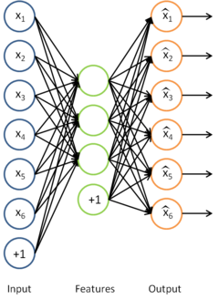
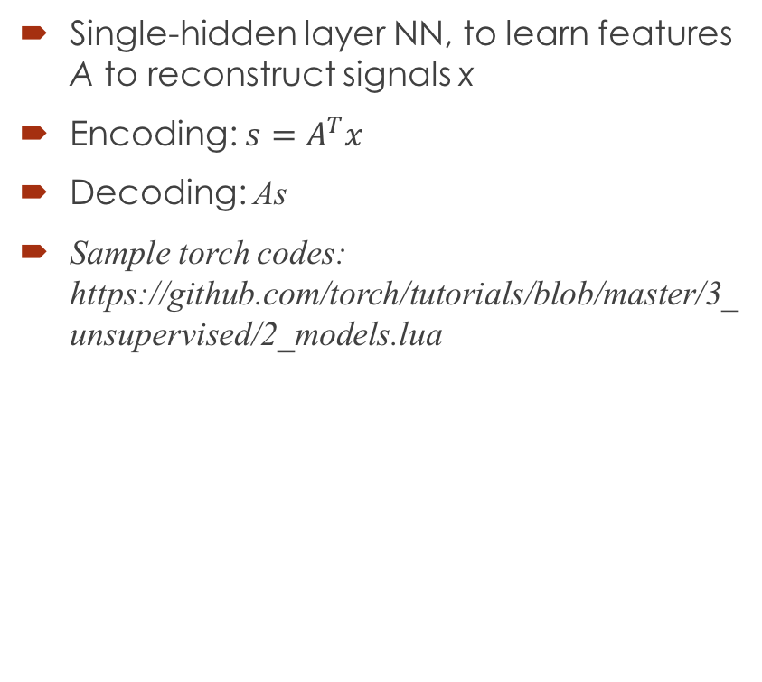
A Neural Network Interpretation: Sparse Autoencoder
Single-hidden layer NN, to learn features A to reconstruct signals x
Encoding: ${s=A}^{T}x$
Decoding: As
Sample torch codes: https://github.com/torch/tutorials/blob/master/3_unsupervised/2_models.lua
-- encoder
 | encoder = nn.Sequential()
 | encoder:add(nn.Linear(inputSize,outputSize))
 | encoder:add(nn.Tanh())
 | encoder:add(nn.Diag(outputSize))
 | -- decoder
 | decoder = nn.Sequential()
 | decoder:add(nn.Linear(outputSize,inputSize))
 | -- tied weights
 | if params.tied and not params.hessian then
 | -- impose weight sharing
 | decoder:get(1).weight = encoder:get(1).weight:t()
 | decoder:get(1).gradWeight = encoder:get(1).gradWeight:t()

Slide 42
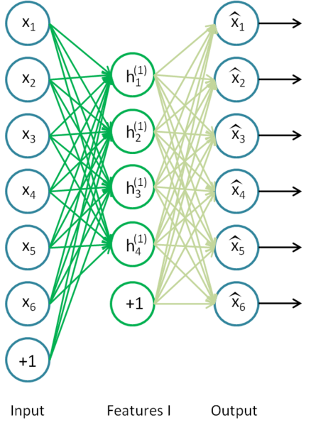
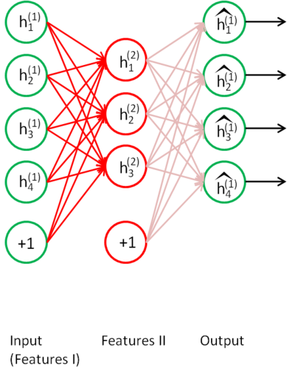
Deep Networks

Slide 43
When does Dictionary Learning work?
Daniel Spielman, Huan Wang, and John Wright, Exact Recovery of Sparsely-Used Dictionaries, arXiv:1206.5882
Agarwal, Anandkumar, Jain, Netrapalli, Learning Sparsely Used Overcomplete Dictionaries via Alternating Minimization, arXiv:1310.7991
Sanjeev Arora, Rong Ge, and Ankur Moistra, New Algorithms for Learning Incoherent and Overcomplete Dictionaries, arXiv:1308.6273, 2013
Barak, Kelner, and Steurer, Dictionary Learning and Tensor Decomposition via the Sum-of-Squares Method, http://arxiv.org/abs/1407.1543, 2014

Slide 44
Application of Deep Learning: Neurostyle

Slide 45
Neural Style by J C Johnson
Website: https://github.com/jcjohnson/neural-style
A torch implementation of the paper
A Neural Algorithm of Artistic Style,
by Leon A. Gatys, Alexander S. Ecker, and Matthias Bethge.
http://arxiv.org/abs/1508.06576

Slide 46
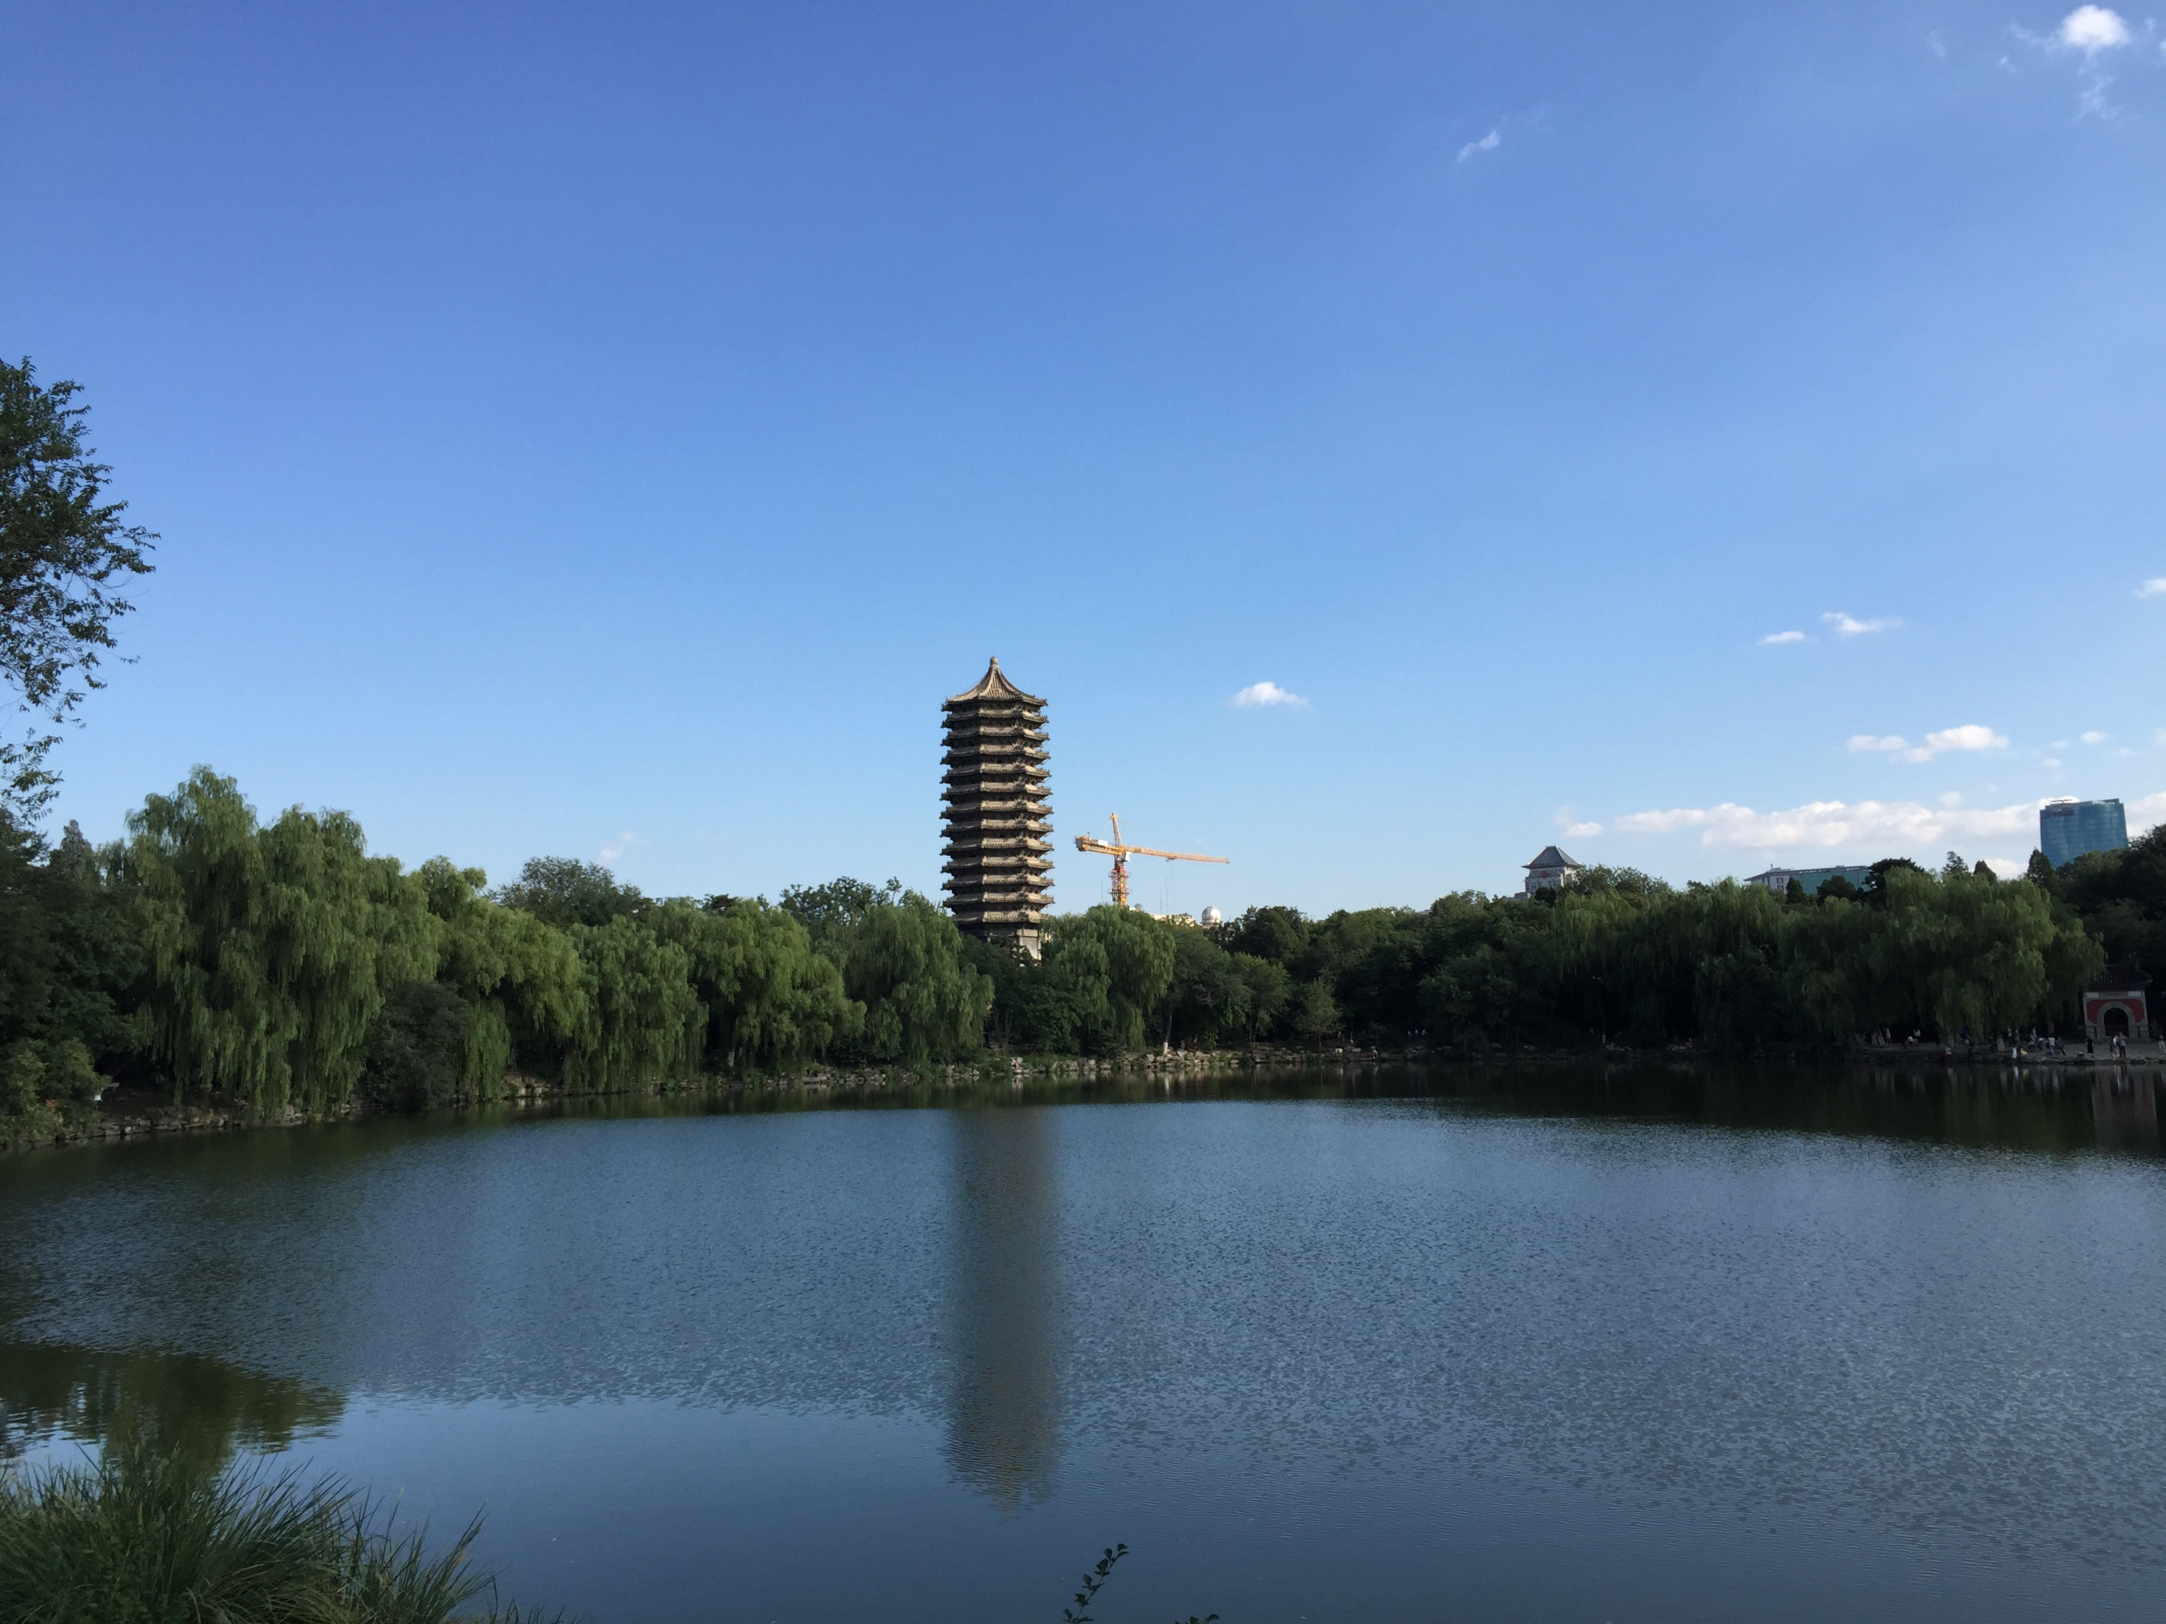
博雅塔·未名湖

Slide 47
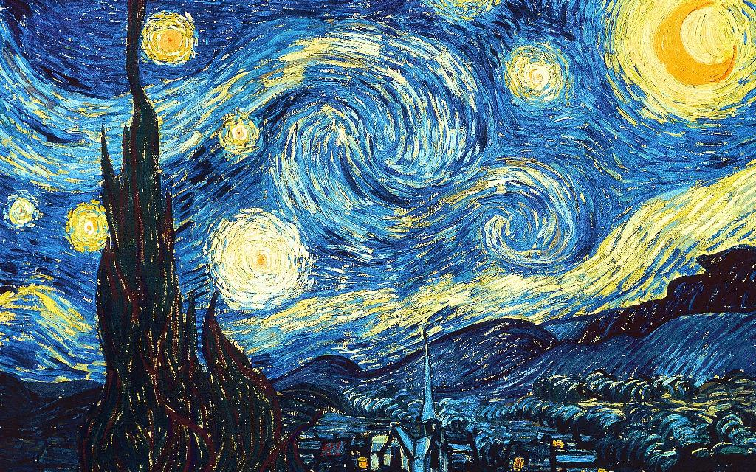
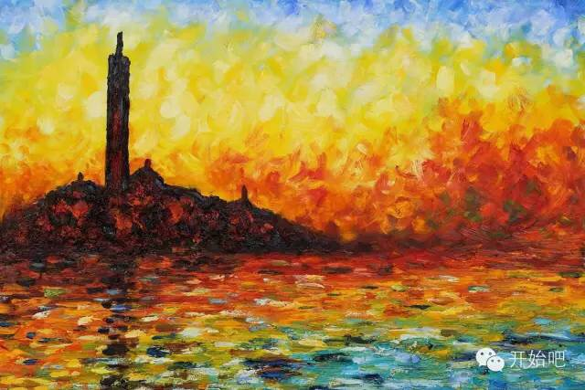
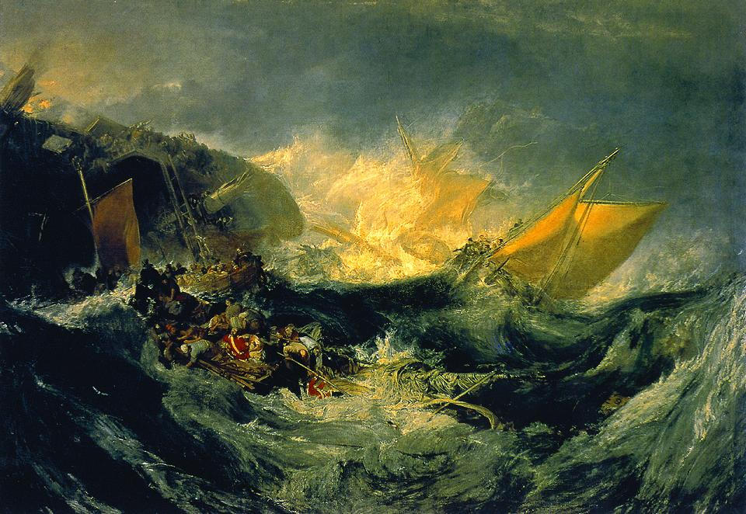
Left: Vincent Van Gogh, Starry Night
Right: Claude Monet, Twilight Venice
Bottom: William Turner, Ship Wreck

Slide 48
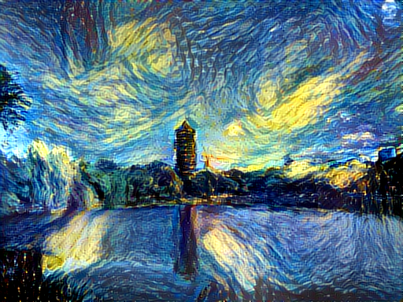
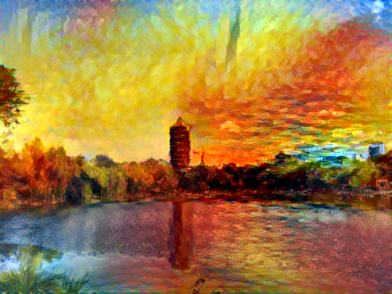
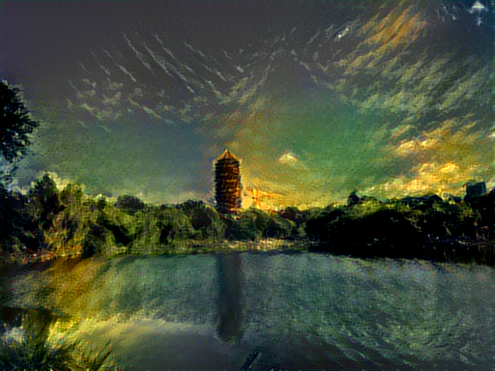
Application of Deep Learning: Content-Style synthetic pictures
By “neural-style”

Slide 49
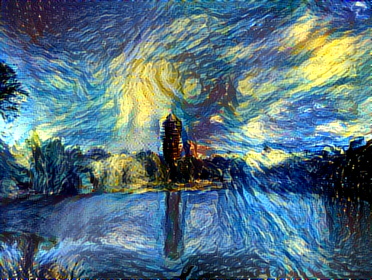
Run neural_style
ssh bicmr@bicmr2 -p 2211
cd neural-style/
th neural_style.lua -style_image examples/inputs/starry_night.jpg -content_image examples/inputs/noname.jpg -output_image examples/outputs/noname_starry.png
Different run might be different!

Slide 50
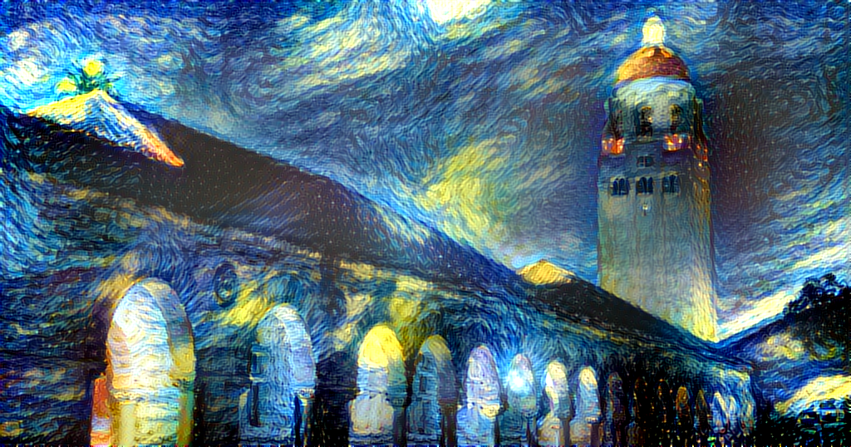
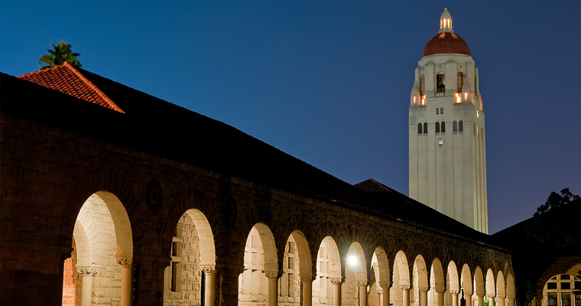
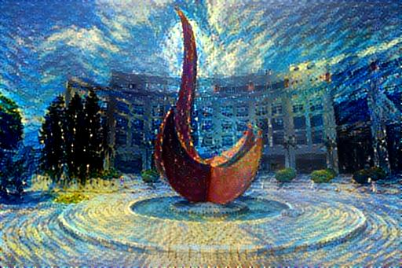
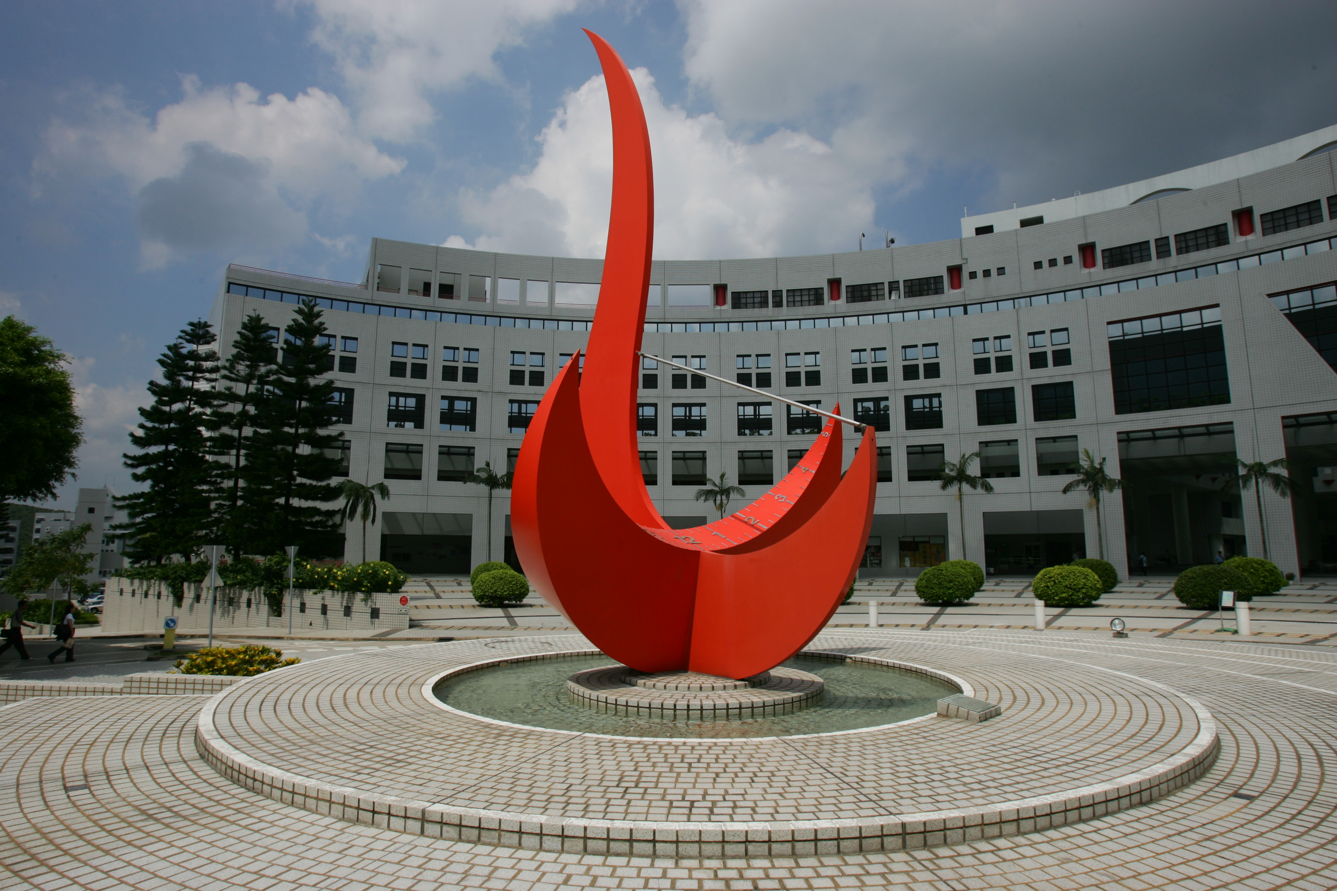

Slide 51
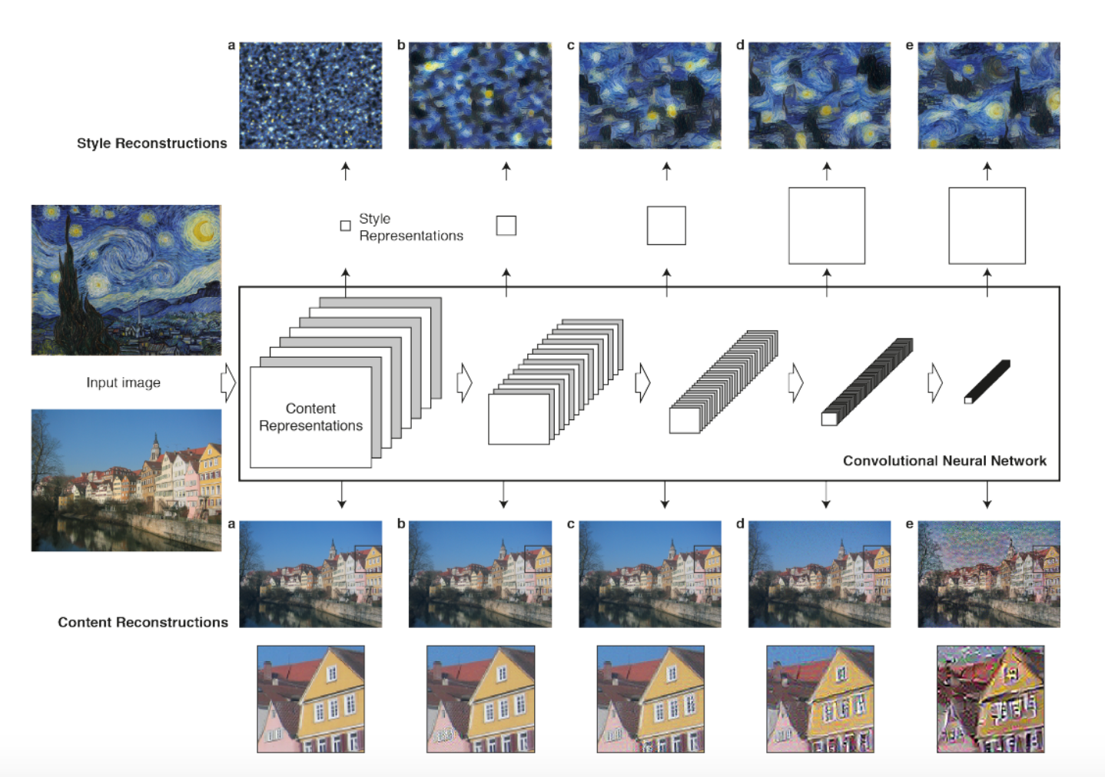
Style-Content Decomposition

